Slide 1
Brief History of VHDL

Slide 2
VHDL
VHDL is a language for describing digital hardware used by industry worldwide
  VHDL is an acronym for VHSIC (Very High Speed Integrated Circuit) Hardware Description Language
Notes:
8

Slide 3
VHDL vs. Verilog
Government Developed | Commercially Developed
Ada based | C based
Strongly Type Cast | Mildly Type Cast
Difficult to learn | Easier to Learn
More Powerful | Less Powerful

Slide 4
Features of VHDL and Verilog
Technology/vendor independent
Portable
Reusable

Slide 5
VHDL Design Flows

Slide 6

World of Integrated Circuits
Integrated Circuits
Full-Custom
ASICs
Semi-Custom
ASICs
(std cell)
User
Programmable
PLD
FPGA
PAL
PLA
PML
LUT
(Look-Up Table)
MUX
Gates

Slide 7
ASIC versus FPGA
ASIC
Application Specific
Integrated Circuit
FPGA
Field Programmable
Gate Array
designs must be sent
for expensive and time
consuming fabrication
in semiconductor foundry
bought off the shelf
and reconfigured by
designers themselves
designed all the way
from behavioral description
to physical layout
no physical layout design;
design ends with a bitstream
used to configure a device

Slide 8
Which Way to Go?
ASICs
FPGAs
Off-the-shelf
High performance
Low development cost
Low power
Short time to market
Low cost in
high volumes
Reconfigurability

Slide 9
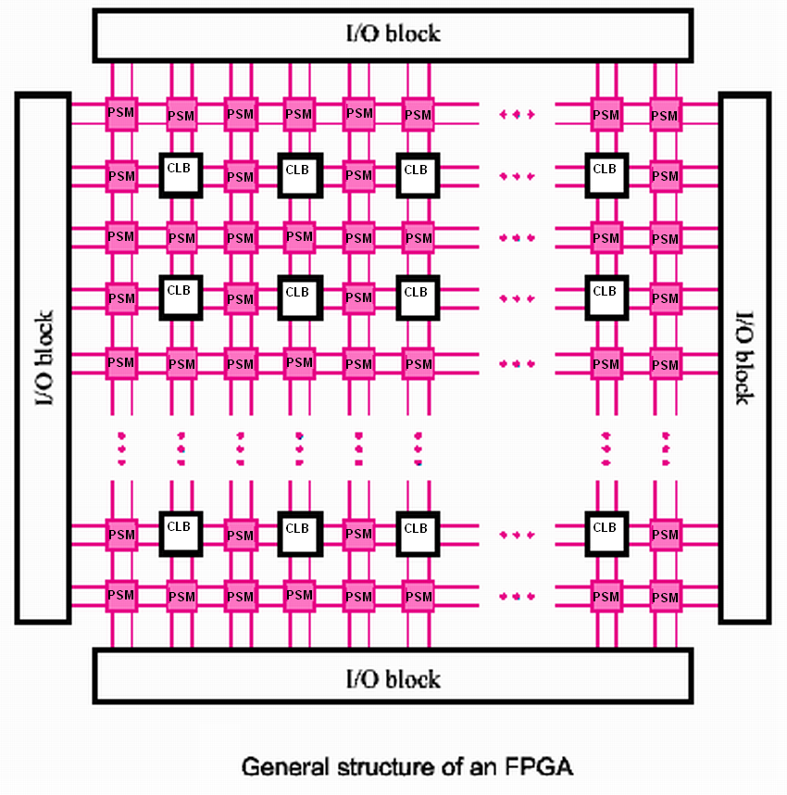
What is an FPGA Chip ?
Field Programmable Gate Array
A chip that can be configured by user to implement different digital hardware
Configurable Logic Blocks (CLB) and Programmable Switch Matrices
Bitstream to configure: function of each block & the interconnection between logic blocks
I/O Block
I/O Block
I/O Block
I/O Block
Source: [Brown99]

Slide 10
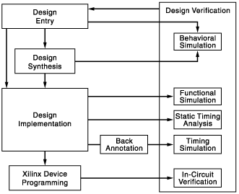
FPGA Design Flow (Overview)
VHDL SOURCE
LOGIC SYNTHESIS
TO GATES
MAPPING
PLACEMENT
ROUTING
BITSTREAM
GENERATION
AND PROGRAMMING
(UNIQUE TO FPGAs)
From www.xilinx.com

Slide 11
VHDL Fundamentals

Slide 12
Case Sensitivity
VHDL is not case sensitive
  Example:
    Names or labels
      databus
      Databus
      DataBus
      DATABUS
    are all equivalent

Slide 13
Naming and Labeling
General rules of thumb (according to VHDL-87)
All names should start with an alphabet character (a-z or A-Z)
Use only alphabet characters (a-z or A-Z) digits (0-9) and underscore (_)
Do not use any punctuation or reserved characters within a name (!, ?, ., &, +, -, etc.)
Do not use two or more consecutive underscore characters (__) within a name (e.g., Sel__A is invalid)
All names and labels in a given entity and architecture must be unique

Slide 14
Free Format
VHDL is a “free format” language
No formatting conventions, such as spacing or indentation imposed by VHDL compilers. Space and carriage return treated the same way.
  Example:
      if (a=b) then
    or
      if (a=b) then
    or
      if (a =
      b) then
    are all equivalent

Slide 15
Comments
Comments in VHDL are indicated with
a “double dash”, i.e., “--”
    Comment indicator can be placed anywhere in the line
    Any text that follows in the same line is treated as
    a comment
    Carriage return terminates a comment
    No method for commenting a block extending over a couple of lines
Examples:
-- main subcircuit
Data_in <= Data_bus; -- reading data from the input FIFO

Slide 16
Comments
Explain function of module to other designers
Explanatory, not just restatement of code
Locate close to code described
  Put near executable code, not just in a header

Slide 17
Design Entity

Slide 18
Example: NAND Gate
a | b | z
0 | 0 | 1
0 | 1 | 1
1 | 0 | 1
1 | 1 | 0
a
z
b

Slide 19
Example VHDL Code
3 sections to a piece of VHDL code
File extension for a VHDL file is .vhd
Name of the file is usually the entity name (nand_gate.vhd)
LIBRARY ieee;
USE ieee.std_logic_1164.all;
ENTITY nand_gate IS
PORT(
a : IN STD_LOGIC;
b : IN STD_LOGIC;
z : OUT STD_LOGIC);
END nand_gate;
ARCHITECTURE model OF nand_gate IS
BEGIN
z <= a NAND b;
END model;
LIBRARY DECLARATION
ENTITY
ARCHITECTURE

Slide 20
Fundamental Parts Of A Library
Library is a collection of commonly used pieces of code, grouped for reuse.
LIBRARY
PACKAGE 1
PACKAGE 2
TYPES
CONSTANTS
FUNCTIONS
PROCEDURES
COMPONENTS
TYPES
CONSTANTS
FUNCTIONS
PROCEDURES
COMPONENTS

Slide 21
Library Declarations
LIBRARY ieee;
USE ieee.std_logic_1164.all;
ENTITY nand_gate IS
PORT(
a : IN STD_LOGIC;
b : IN STD_LOGIC;
z : OUT STD_LOGIC);
END nand_gate;
ARCHITECTURE model OF nand_gate IS
BEGIN
z <= a NAND b;
END model;
Library declaration
Use all definitions from the package
std_logic_1164

Slide 22
Library Declarations - Syntax
LIBRARY library_name;
USE library_name.package_name.package_parts;

Slide 23
Design Entity
design entity
entity declaration
Design Entity - most basic building block of a design.
One entity can have many different architectures.
architecture 1
architecture 2
architecture 3

Slide 24
Entity Declaration
Entity Declaration describes the interface of the component, i.e. input and output ports.
Entity name
Port names
Port type
Semicolon
ENTITY nand_gate IS
PORT(
a : IN STD_LOGIC;
b : IN STD_LOGIC;
z : OUT STD_LOGIC
);
END nand_gate;
No Semicolon after last port
Reserved words
Port modes (data flow directions)

Slide 25
Entity Declaration – Simplified Syntax
ENTITY entity_name IS
PORT (
port_name : port_mode signal_type;
port_name : port_mode signal_type;
………….
port_name : port_mode signal_type);
END entity_name;

Slide 26
Port Mode IN
Port signal
Entity
a
Driver resides
outside the entity

Slide 27
Port Mode OUT
Entity
Port signal
z
c
Output cannot be read within the entity
Driver resides
inside the entity
c <= z

Slide 28
Port Mode OUT (with extra signal)
Entity
Port signal
x
z
c
Signal x can be
read inside the entity
Driver resides
inside the entity
z <= x
c <= x

Slide 29
Port Mode BUFFER
Entity
Port signal
z
c
Port signal Z can be
read inside the entity
Driver resides
inside the entity
c <= z

Slide 30
Port Mode INOUT
Port signal
Entity
a
Signal can be
read inside the entity
Driver may reside
both inside and outside
of the entity

Slide 31
Port Modes: Summary
The Port Mode of the interface describes the direction in which data travels with respect to the component
  In: Data comes in this port and can only be read within the entity. It can appear only on the right side of a signal or variable assignment.
  Out: The value of an output port can only be updated within the entity. It cannot be read. It can only appear on the left side of a signal assignment.
  Inout: The value of a bi-directional port can be read and updated within the entity model. It can appear on both sides of a signal assignment.
  INOUT AND BUFFER NOT USED
  Buffer: Used for a signal that is an output from an entity. The value of the signal can be used inside the entity, which means that in an assignment statement the signal can appear on the left and right sides of the <= operator

Slide 32
Architecture
Entity describes the ports of the module
Architecture describes the functionality of the module (i.e. what does the module do)
Architecture example:
ARCHITECTURE model OF nand_gate IS
BEGIN
z <= a NAND b;
END model;

Slide 33
Architecture – Simplified Syntax
ARCHITECTURE architecture_name OF entity_name IS
[ declarations ]
BEGIN
code
END architecture_name;

Slide 34
Entity Declaration & Architecture
nand_gate.vhd
LIBRARY ieee;
USE ieee.std_logic_1164.all;
ENTITY nand_gate IS
PORT(
a : IN STD_LOGIC;
b : IN STD_LOGIC;
z : OUT STD_LOGIC);
END nand_gate;
ARCHITECTURE model OF nand_gate IS
BEGIN
z <= a NAND b;
END model;

Slide 35
STD_LOGIC Demystified

Slide 36
STD_LOGIC
LIBRARY ieee;
USE ieee.std_logic_1164.all;
ENTITY nand_gate IS
PORT(
a : IN STD_LOGIC;
b : IN STD_LOGIC;
z : OUT STD_LOGIC);
END nand_gate;
ARCHITECTURE model OF nand_gate IS
BEGIN
z <= a NAND b;
END model;
What is STD_LOGIC you ask?

Slide 37
BIT versus STD_LOGIC
BIT type can only have a value of ‘0’ or ‘1’
STD_LOGIC can have nine values
  'U',‘0’,’1’,’X’,’Z’,’W’,’L’,’H’,’-’
  Useful mainly for simulation
  ‘0’,’1’, and ‘Z’ are synthesizable

Slide 38
STD_LOGIC type demystified
Value | Meaning
'U' | Uninitialized
‘X’ | Forcing (Strong driven) Unknown
‘0’ | Forcing (Strong driven) 0
‘1’ | Forcing (Strong driven) 1
‘Z’ | High Impedance
‘W’ | Weak (Weakly driven) Unknown
‘L’ | Weak (Weakly driven) 0. Models a pull down.
‘H’ | Weak (Weakly driven) 1. Models a pull up.
‘-’ | Don't Care

Slide 39
STD_LOGIC Rules
Use std_logic or std_logic_vector for all entity input or output ports
  Do not use integer, unsigned, signed, bit for ports
  Can use other types inside an architecture if desired
  Can use other types in generics
Instead use std_logic_vector and a conversion function inside your architecture

Slide 40
Modeling Wires and Buses

Slide 41
Single Wire Versus Bus
SIGNAL a : STD_LOGIC;
a
1
wire
SIGNAL b : STD_LOGIC_VECTOR(7 downto 0);
b
bus
8

Slide 42
Standard Logic Vectors
SIGNAL a: STD_LOGIC;
SIGNAL b: STD_LOGIC_VECTOR(3 DOWNTO 0);
SIGNAL c: STD_LOGIC_VECTOR(3 DOWNTO 0);
SIGNAL d: STD_LOGIC_VECTOR(7 DOWNTO 0);
SIGNAL e: STD_LOGIC_VECTOR(15 DOWNTO 0);
SIGNAL f: STD_LOGIC_VECTOR(8 DOWNTO 0);
……….
a <= '1';
b <= "0000"; -- Binary base assumed by default
c <= B"0000"; -- Binary base explicitly specified
d <= "0110_0111"; -- You can use '_' to increase readability
e <= X"AF67"; -- Hexadecimal base
f <= O"723"; -- Octal base

Slide 43
Single versus Double Quote
Use single quote to hold a single bit signal
  a <= '0', a <='Z'
Use double quote to hold a multi-bit signal
  b <= "00", b <= "11"

Slide 44
Vectors and Concatenation
SIGNAL a: STD_LOGIC_VECTOR(3 DOWNTO 0);
SIGNAL b: STD_LOGIC_VECTOR(3 DOWNTO 0);
SIGNAL c, d, e: STD_LOGIC_VECTOR(7 DOWNTO 0);
a <= "0000";
b <= "1111";
c <= a & b; -- c = "00001111"
d <= '0' & "0001111"; -- d <= "00001111"
e <= '0' & '0' & '0' & '0' & '1' & '1' &
'1' & '1'; -- e <= "00001111"

Slide 45
STD_LOGIC versus STD_ULOGIC
STD_LOGIC resolves types which conflict via the conflict resolution table
STD_ULOGIC does not allow for conflicts on buses and will not resolve multiple sources for a signal
We only use STD_LOGIC in this course

Slide 46
VHDL Design Styles

Slide 47
VHDL Design Styles (Architecture)
VHDL Design
Styles
BEHAVIORAL
DATAFLOW
STRUCTURAL
SYTHESIZABLE
NON-
SYNTHESIZABLE
“concurrent”
statements
components and
interconnects
“sequential” statements
State machines
Registers
Test Benches
Modeling IP
VHDL subset most suitable for synthesis

Slide 48
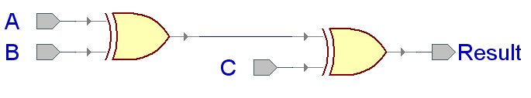
XOR3 Example

Slide 49
Entity XOR3 (same for all architectures)
LIBRARY ieee;
USE ieee.std_logic_1164.all;
ENTITY xor3 IS
PORT(
A : IN STD_LOGIC;
B : IN STD_LOGIC;
C : IN STD_LOGIC;
Result : OUT STD_LOGIC
);
END xor3;

Slide 50
Dataflow Architecture
ARCHITECTURE dataflow OF xor3 IS
SIGNAL U1_out: STD_LOGIC;
BEGIN
U1_out <= A XOR B;
Result <= U1_out XOR C;
END dataflow;
U1_out

Slide 51
Dataflow Description
Describes how data moves through the system and the various processing steps.
  Dataflow uses series of concurrent statements to realize logic.
  Dataflow is most useful style when series of Boolean equations can represent a logic → used to implement simple combinational logic
  Dataflow code also called “concurrent” code (Pedroni)
Concurrent statements are evaluated at the same time; thus, the order of these statements doesn’t matter
  This is not true for sequential/behavioral statements
    This order…
    U1_out <= A XOR B;
    Result <= U1_out XOR C;
    Is the same as this order…
    Result <= U1_out XOR C;
    U1_out <= A XOR B;

Slide 52
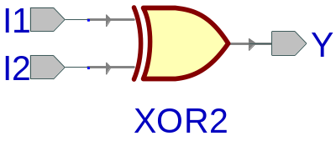
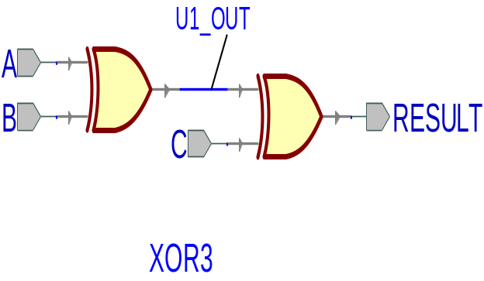
Structural Architecture (XOR3 gate)
ARCHITECTURE structural OF xor3 IS
SIGNAL U1_OUT: STD_LOGIC;
COMPONENT xor2 IS
PORT(
I1 : IN STD_LOGIC;
I2 : IN STD_LOGIC;
Y : OUT STD_LOGIC
);
END COMPONENT;
BEGIN
U1: xor2 PORT MAP ( I1 => A,
I2 => B,
Y => U1_OUT);
U2: xor2 PORT MAP ( I1 => U1_OUT,
I2 => C,
Y => Result);
END structural;
A
B
XOR3
Result
C

Slide 53
Component and Instantiation
Named association connectivity (recommended)
COMPONENT xor2 IS
PORT(
I1 : IN STD_LOGIC;
I2 : IN STD_LOGIC;
Y : OUT STD_LOGIC
);
END COMPONENT;
BEGIN
U1: xor2 PORT MAP ( I1 => A,
I2 => B,
Y => U1_OUT);
...
COMPONENT PORT NAME
LOCAL WIRE

Slide 54
Component and Instantiation
Positional association connectivity
(not recommended)
COMPONENT xor2 IS
PORT(
I1 : IN STD_LOGIC;
I2 : IN STD_LOGIC;
Y : OUT STD_LOGIC
);
END COMPONENT;
BEGIN
U1: xor2 PORT MAP (A, B, U1_OUT);
...

Slide 55
Structural Description
Structural design is the simplest to understand. This style is the closest to schematic capture and utilizes simple building blocks to compose logic functions.
Components are interconnected in a hierarchical manner.
Structural descriptions may connect simple gates or complex, abstract components.
Structural style is useful when expressing a design that is naturally composed of sub-blocks.
  Structural style used for complex designs, and will be used for the project

Slide 56
Behavioral Architecture (XOR3 gate)
ARCHITECTURE behavioral OF xor3 IS
BEGIN
PROCESS (A,B,C)
BEGIN
IF ((A XOR B XOR C) = '1') THEN
Result <= '1';
ELSE
Result <= '0';
END IF;
END PROCESS;
END behavioral;

Slide 57
Behavioral Description
It accurately models what happens on the inputs and outputs of the black box (no matter what is inside and how it works).
This style uses PROCESS statements in VHDL.
Statements are executed in sequence in a process statement → order of code matters!

Slide 58
Testbenches

Slide 59
Testbench Block Diagram
Testbench
Processes
Generating
Stimuli
Design Under Test (DUT)
Observed Outputs

Slide 60
Testbench Defined
A testbench applies stimuli (drives the inputs) to the Design Under Test (DUT) and (optionally) verifies expected outputs.
  Design Under Test also called Unit Under Test (UUT)
The results can be viewed in a waveform window or written to a file.
Since a testbench is written in VHDL, it is not restricted to a single simulation tool (portability).
The same testbench can be easily adapted to test different implementations (i.e. different architectures) of the same design.

Slide 61
Testbench Anatomy
ENTITY tb IS
--TB entity has no ports
END tb;
ARCHITECTURE arch_tb OF tb IS
--Local signals and constants
COMPONENT TestComp -- All Design Under Test component declarations
PORT ( );
END COMPONENT;
-----------------------------------------------------
BEGIN
DUT:TestComp PORT MAP( -- Instantiations of DUTs
);
testSequence: PROCESS
-- Input stimuli
END PROCESS;
END arch_tb;

Slide 62
Testbench for XOR3
LIBRARY ieee;
USE ieee.std_logic_1164.all;
ENTITY xor3_tb IS
END xor3_tb;
ARCHITECTURE xor3_tb_architecture OF xor3_tb IS
-- Component declaration of the tested unit
COMPONENT xor3
PORT(
A : IN STD_LOGIC;
B : IN STD_LOGIC;
C : IN STD_LOGIC;
Result : OUT STD_LOGIC );
END COMPONENT;
-- Stimulus signals - signals mapped to the ports of tested entity
SIGNAL test_vector: STD_LOGIC_VECTOR(2 DOWNTO 0);
SIGNAL test_result : STD_LOGIC;
BEGIN
DUT : xor3
PORT MAP (
A => test_vector(0),
B => test_vector(1),
C => test_vector(2),
Result => test_result);

Slide 63
Testbench for XOR3 (2)
PROCESS
BEGIN
test_vector <= "000";
WAIT FOR 10 ns;
test_vector <= "001";
WAIT FOR 10 ns;
test_vector <= "010";
WAIT FOR 10 ns;
test_vector <= "011";
WAIT FOR 10 ns;
test_vector <= "100";
WAIT FOR 10 ns;
test_vector <= "101";
WAIT FOR 10 ns;
test_vector <= "110";
WAIT FOR 10 ns;
test_vector <= "111";
WAIT;
END PROCESS;
END xor3_tb_architecture;

Slide 64
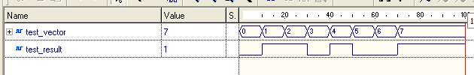
Testbench waveform

Slide 65
What is a PROCESS?
  A process is a sequence of instructions referred to as sequential statements.
The keyword PROCESS
A process can be given a unique name using an optional LABEL
This is followed by the keyword PROCESS
The keyword BEGIN is used to indicate the start of the process
All statements within the process are executed SEQUENTIALLY. Hence, order of statements is important!
A process must end with the keywords END PROCESS.
Testing: PROCESS
BEGIN
test_vector<=“00”;
WAIT FOR 10 ns;
test_vector<=“01”;
WAIT FOR 10 ns;
test_vector<=“10”;
WAIT FOR 10 ns;
test_vector<=“11”;
WAIT FOR 10 ns;
END PROCESS;

Slide 66
Execution of statements in a PROCESS
Testing: PROCESS
BEGIN
test_vector<=“00”;
WAIT FOR 10 ns;
test_vector<=“01”;
WAIT FOR 10 ns;
test_vector<=“10”;
WAIT FOR 10 ns;
test_vector<=“11”;
WAIT FOR 10 ns;
END PROCESS;
The execution of statements continues sequentially till the last statement in the process.
After execution of the last statement, the control is again passed to the beginning of the process.
Order of execution
Program control is passed to the first statement after BEGIN

Slide 67
PROCESS with a WAIT Statement
The last statement in the PROCESS is a WAIT instead of WAIT FOR 10 ns.
This will cause the PROCESS to suspend indefinitely when the WAIT statement is executed.
This form of WAIT can be used in a process included in a testbench when all possible combinations of inputs have been tested or a non-periodical signal has to be generated.
Testing: PROCESS
BEGIN
test_vector<=“00”;
WAIT FOR 10 ns;
test_vector<=“01”;
WAIT FOR 10 ns;
test_vector<=“10”;
WAIT FOR 10 ns;
test_vector<=“11”;
WAIT;
END PROCESS;
Order of execution
Program execution stops here

Slide 68

WAIT FOR vs. WAIT
WAIT FOR: waveform will keep repeating itself forever
…
0
1
2
3
0
1
2
3
WAIT : waveform will keep its state after the last wait instruction.
…

Slide 69
Loop Statement
Loop Statement
Repeats a section of VHDL Code
  Example: process every element in an array in the same way
FOR i IN range LOOP
statements
END LOOP;

Slide 70
Loop Statement – Example 1
Testing: PROCESS
BEGIN
test_vector<="000";
FOR i IN 0 TO 7 LOOP
WAIT FOR 10 ns;
test_vector<=test_vector+"001";
END LOOP;
END PROCESS;

Slide 71
Loop Statement – Example 2
Testing: PROCESS
BEGIN
test_ab<="00";
test_sel<="00";
FOR i IN 0 TO 3 LOOP
FOR j IN 0 TO 3 LOOP
WAIT FOR 10 ns;
test_ab<=test_ab+"01";
END LOOP;
test_sel<=test_sel+"01";
END LOOP;
END PROCESS;

